Slide 1

Researchin android application
Kalyani Government Engineering College Kalyani, Nadia
Department of Master of Computer Application
Presented By:
Suhrid Ranjan Das
(Roll No: 10201016007)
Abhro Bhattacharjee
(Roll No: 10201016031)
Year: 3rd (5th Semester)
Under The Guidance Of Dr. Indrajit Bhattacharaya

Slide 2
contents
INTRODUCTION
ABOUT ResearchIN
FUNCTIONS OF ResearchIN
DATA FLOW DIAGRAMS
ENTITY RELATION DIAGRAM
USE CASE DIAGRAM
WORKING OF ResearchIN
FUTURE SCOPE
CONCLUSION
ACKNOWLEDGEMENT
REFERENCES

Slide 3
introduction
In today’s world, Research has become a very important field, not only for Students, but also for Professors and Doctors as well. Many a times researchers tend to search for papers of their interests and would like to view or download them for future use. ResearchIN provides all these features at the researcher’s finger tips, rather then searching for a paper in internet or any website. Also it may happen that may researchers have visited a conference and don’t know each other or their works. ResearchIN would show the registered people around you along with their work description.

Slide 4
About ResearchIN
ResearchIN Android Application is made to create a place where Researchers and people who are interested in similar research works can register, view each other’s works and even download them if proper permissions are granted. Researchers can follow each other so that they get constant update of each other’s works. Finding researchers or registered people nearby and viewing their work is very essential for a researcher who has visited a conference and does not know the other researchers those are around him and about their works. ResearchIN provides a very user-friendly interface to Upload, Download and view Research works of registered researchers and also helps to find users who are nearby each other.

Slide 5
Functions of ResearchIN
The registered users will be able to see the research works of their interests and also of the researchers they are following.
The registered users can view other users who are nearby along with their work and if they find their work interesting, can send request to download their works if not made public by them.
Users can see who they are following as well as which other users are following them.

Slide 6
Functions of ResearchIN
Users can upload papers providing certain information and can also specify if the paper is to be made public for all users or hidden.
Users can view or download papers of their interest.
The search option provides users the facility to search papers based on paper names, interests and author names.

Slide 7
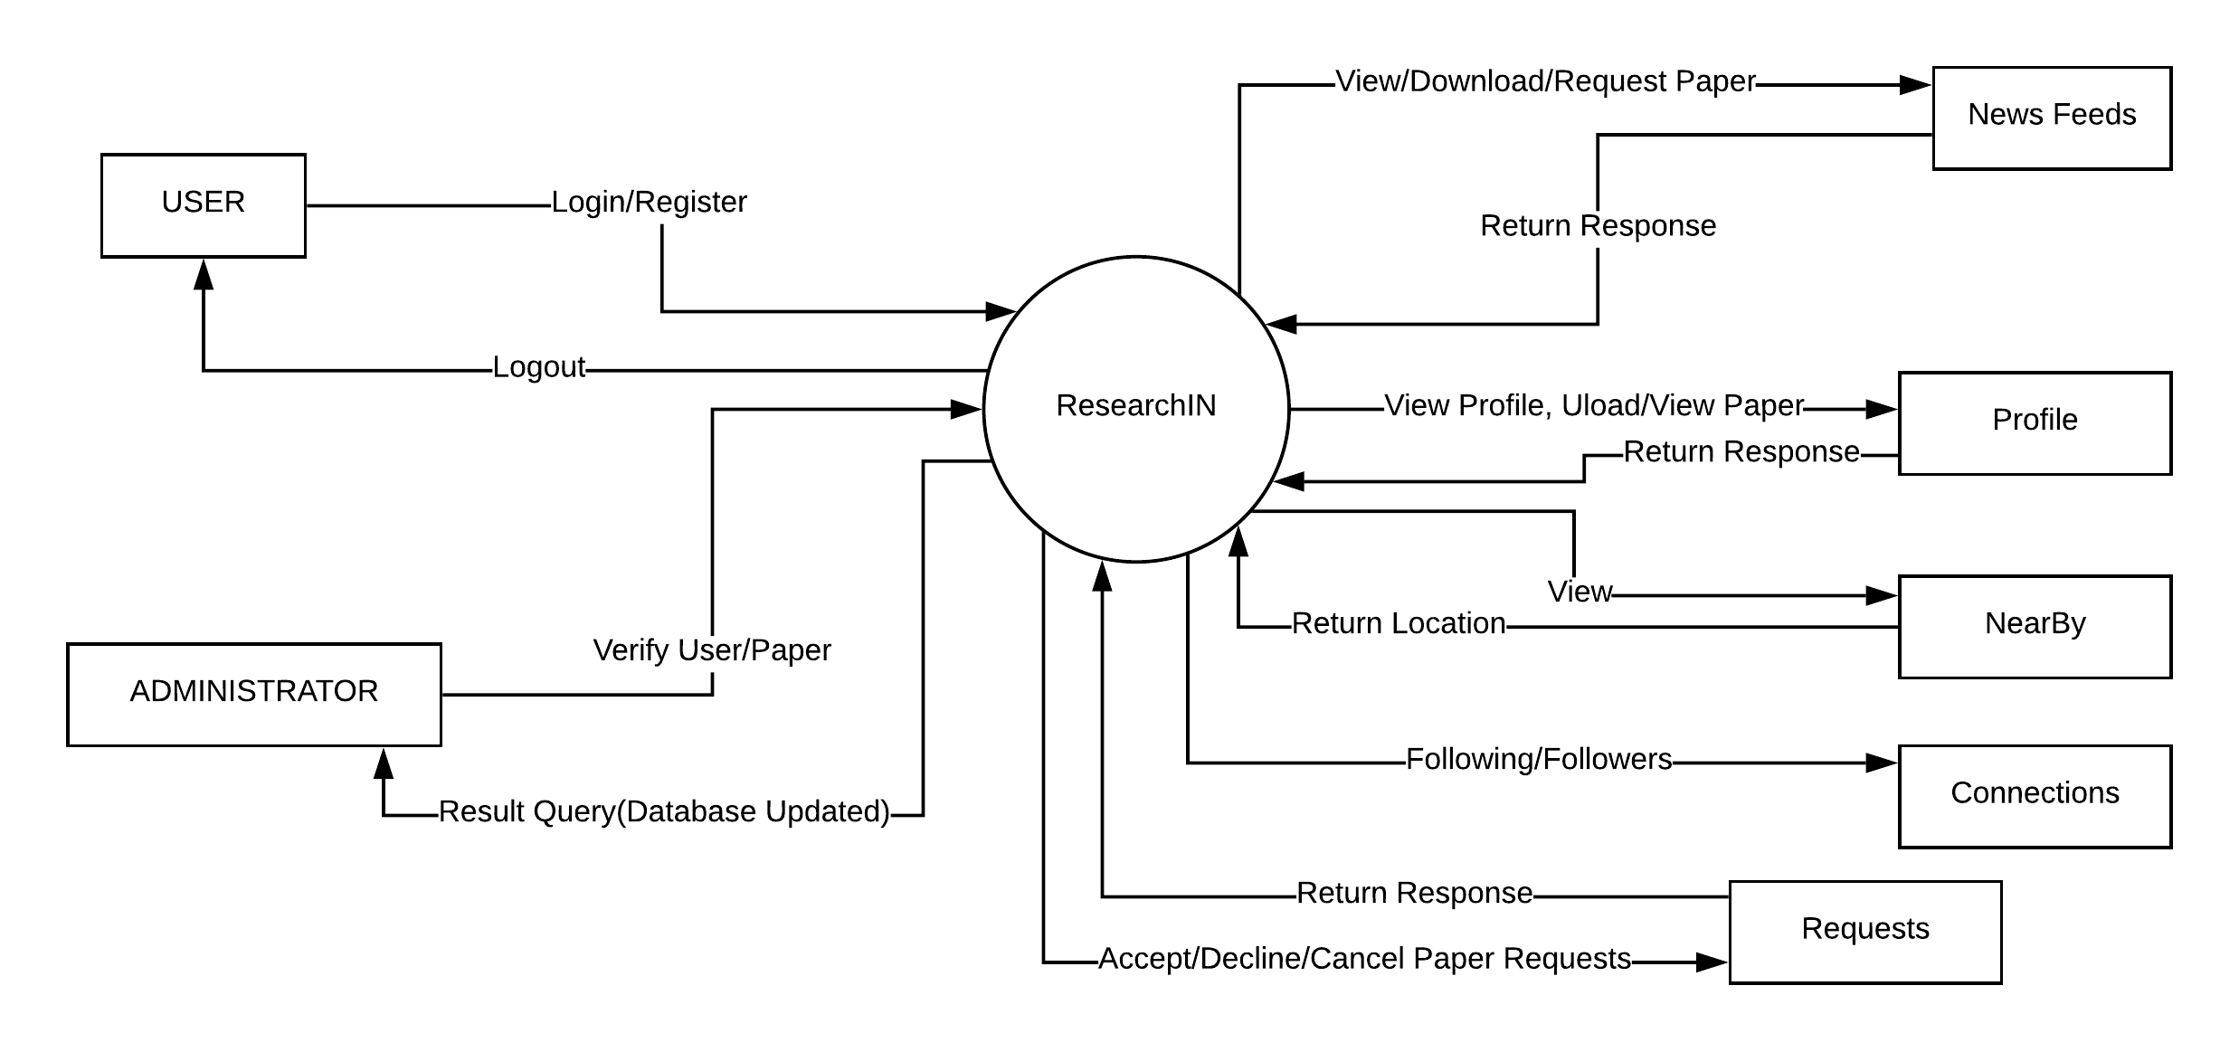
Data flow diagrams
Level 0

Slide 8
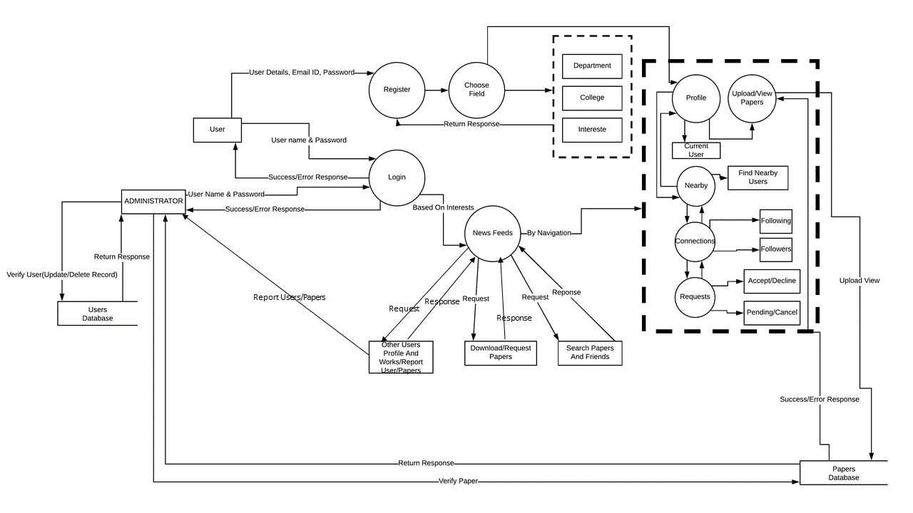
Data flow diagrams
Level 1

Slide 9
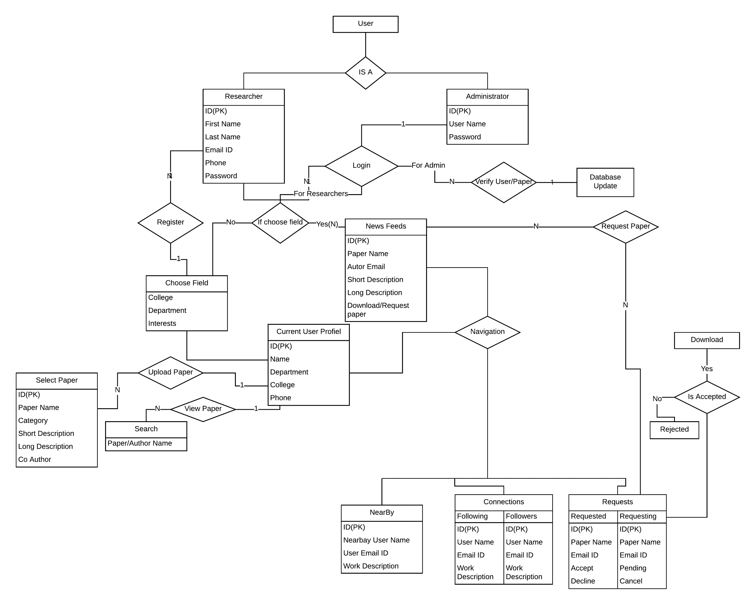
Entity relationship diagram

Slide 10
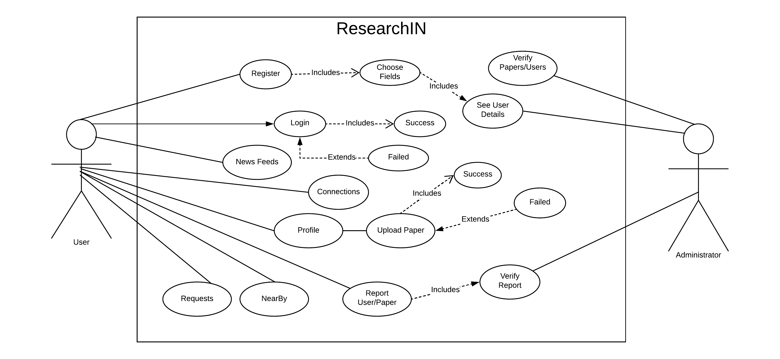
Use case diagram

Slide 11
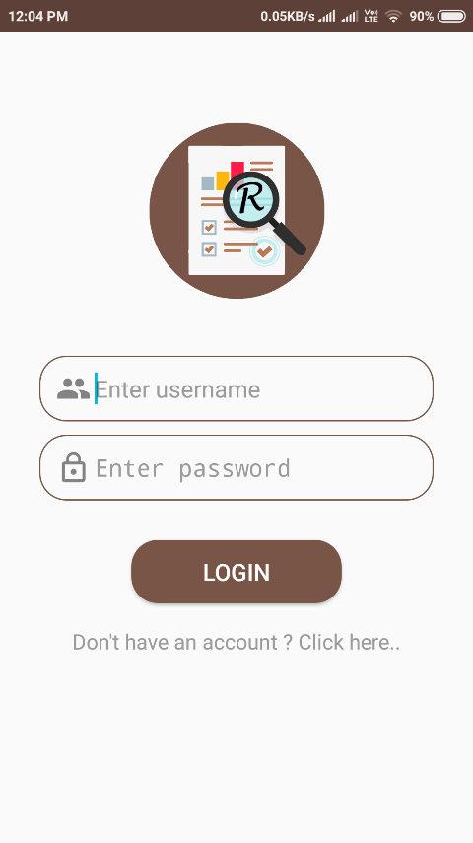
Working of ResearchIN
Login Module
The login module takes input Username and Password that is set by the user during registration, verifies both the inputs and then allows an user to login into the application.

Slide 12
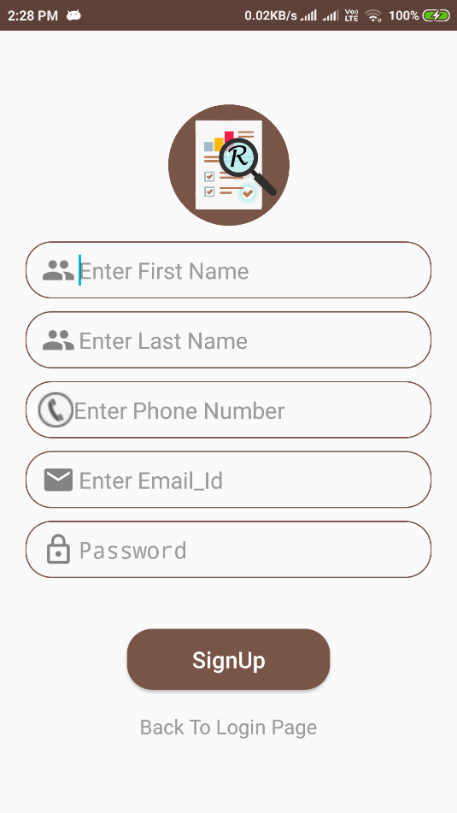
Registration Module
If a user does not have any account created, they he/she cannot just simply login into the application. To do so, one just have to first register themselves through the registration section by providing relevant information like First and Last names, Email ID and Password.

Slide 13
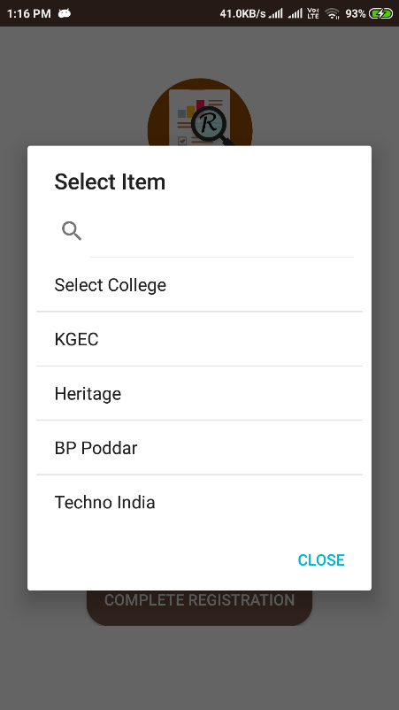
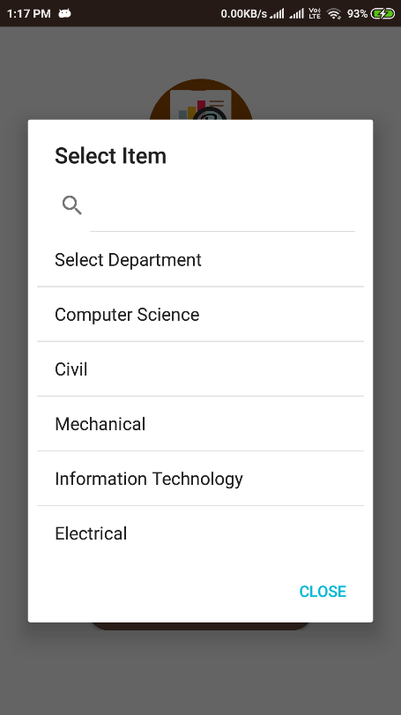
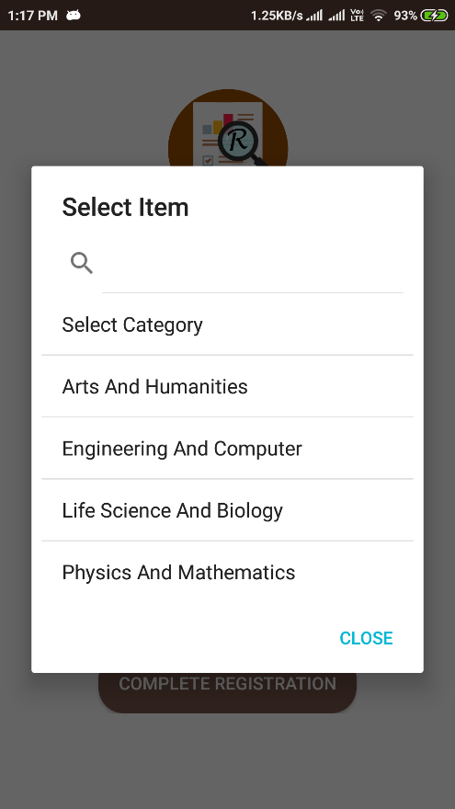
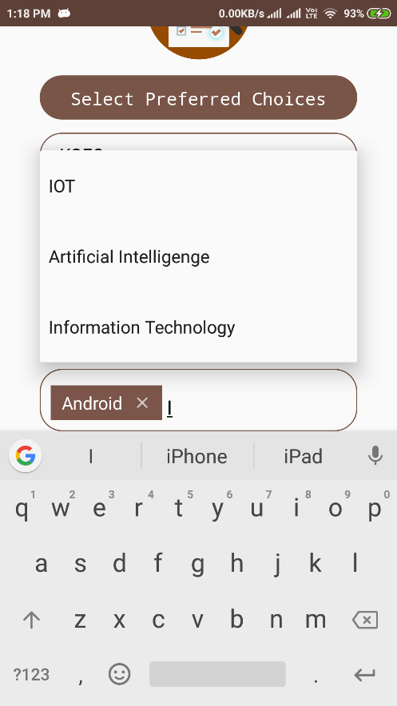
Choose Field Area
After the registration, the user is directed to the Select Choices area when the user has to provide their college, department to which they belong and preferred interests in the area of research or what kind of research works they want to view.

Slide 14
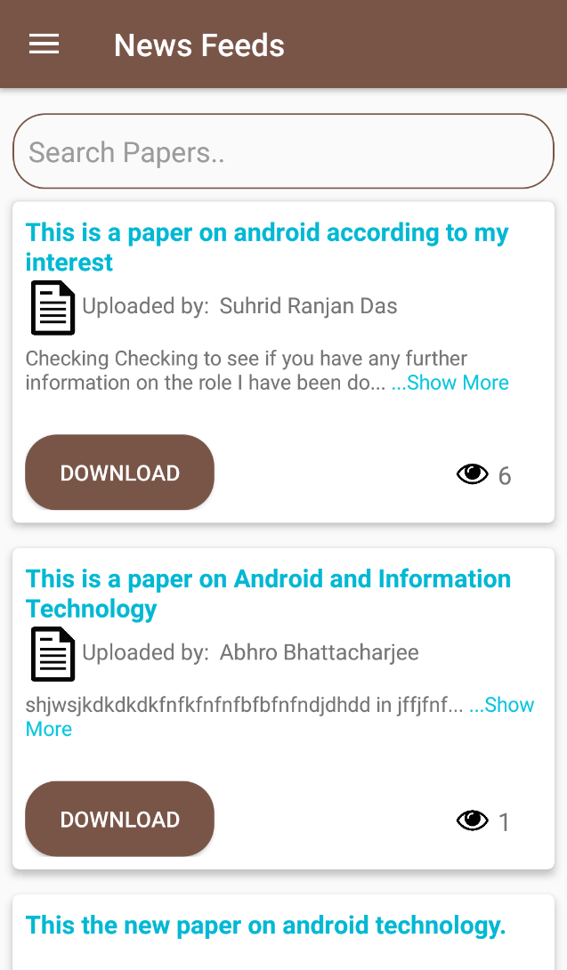
News Feeds
News Feed is the section where users can view different works of different authors based on the interests they have provided during the registration section. If the interests of the user matches with the category of the papers which other users or authors have uploaded, then those works or papers will be displayed in the News Feed of the current user. Each article in the News Feed contain the Paper Heading, Author’s Email ID, a short description and a long description of the work done. If the user feels the work to be intriguing and of their interest, they can download the paper by clicking on the Download button for the full paper or request the author for full paper download access if the paper is download restricted.

Slide 15
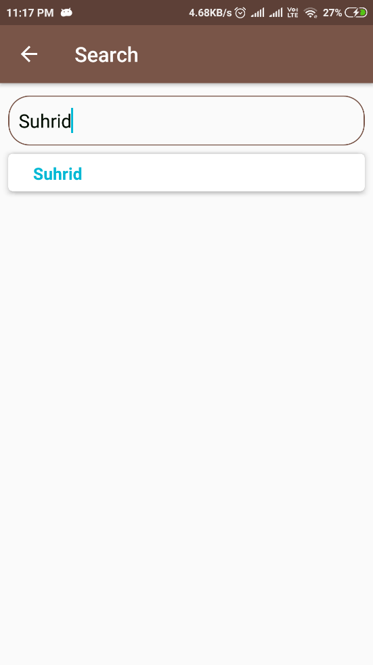
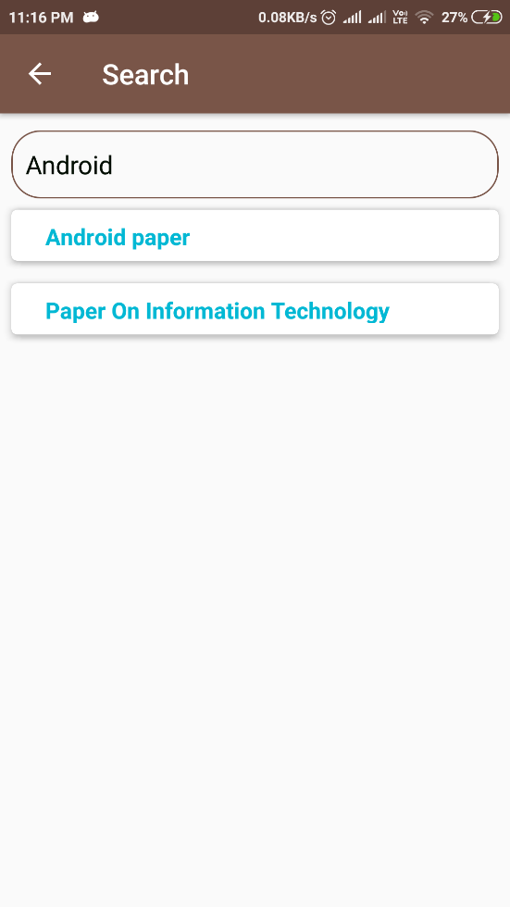
Search Papers
The Search functionality of ResearchIN provides the users with the ability to search for works by either typing a keyword or paper name and even researcher or author’s name. For example, if the user types Android, all the papers having android keyword in it will be displayed in the form of a list. If the user searches by providing any Author’s name, then the authors will be displayed.

Slide 16
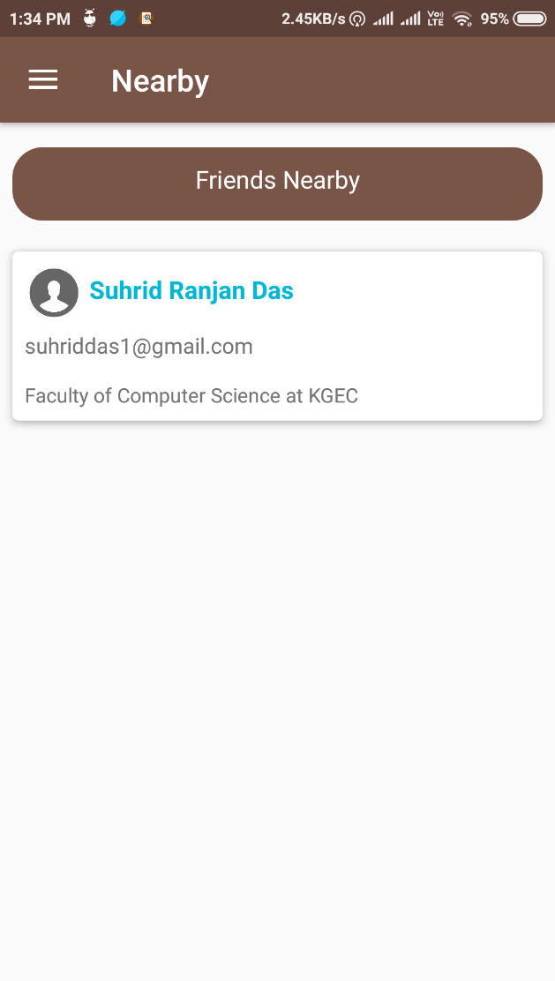
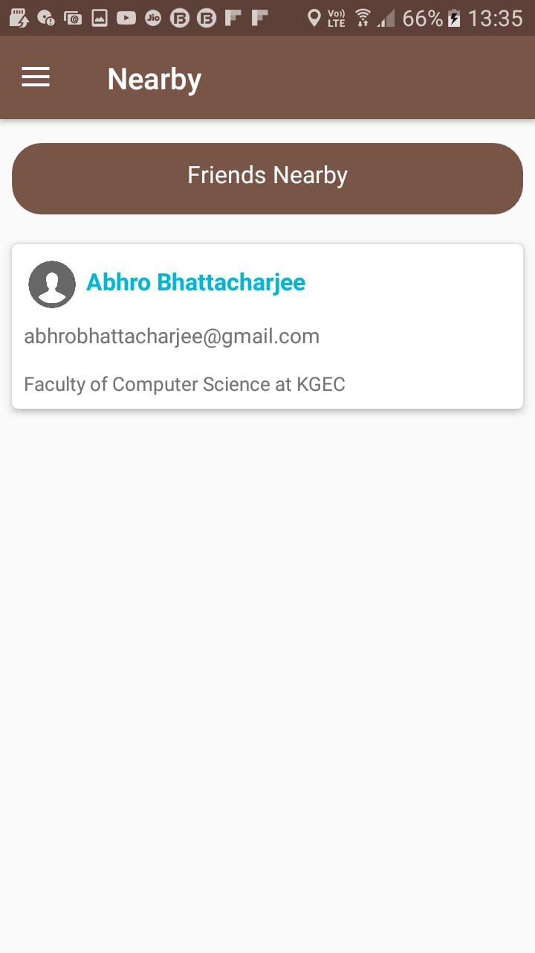
Nearby
Nearby is an unique feature of the ResearchIN Android Application that helps to find registered users who are nearby each other within a certain proximity. This feature is very useful for Researchers who are attending any conference or having a meet, they can find other registered Researchers and know about them and their works.

Slide 17
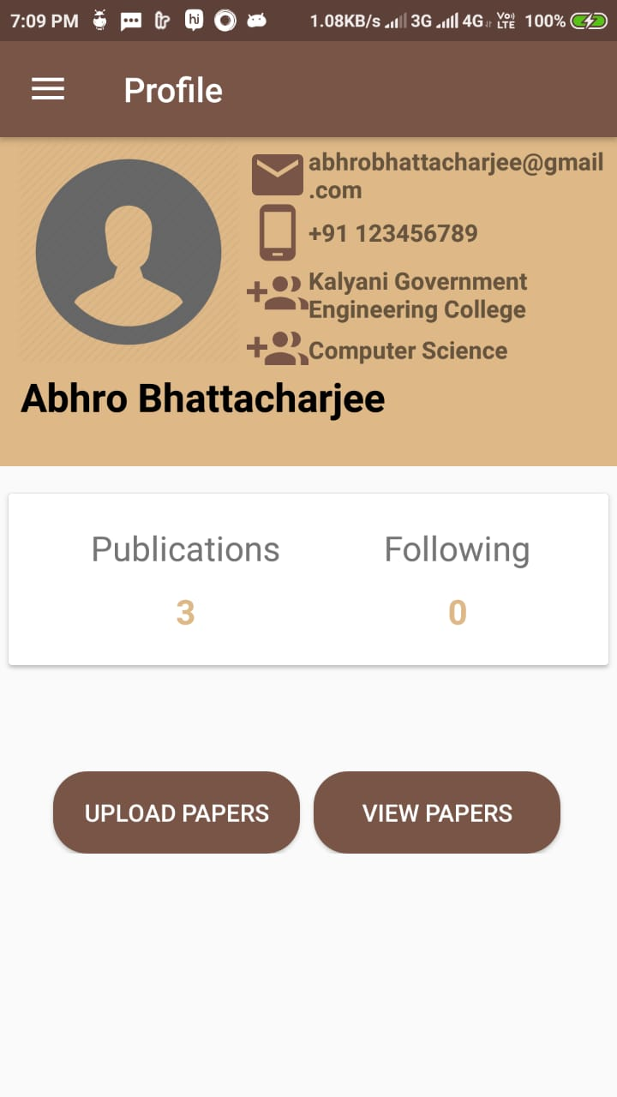
Profile
In the profile section the current user can view his/her details, publications, following and also can go to the upload paper section and view paper section.

Slide 18
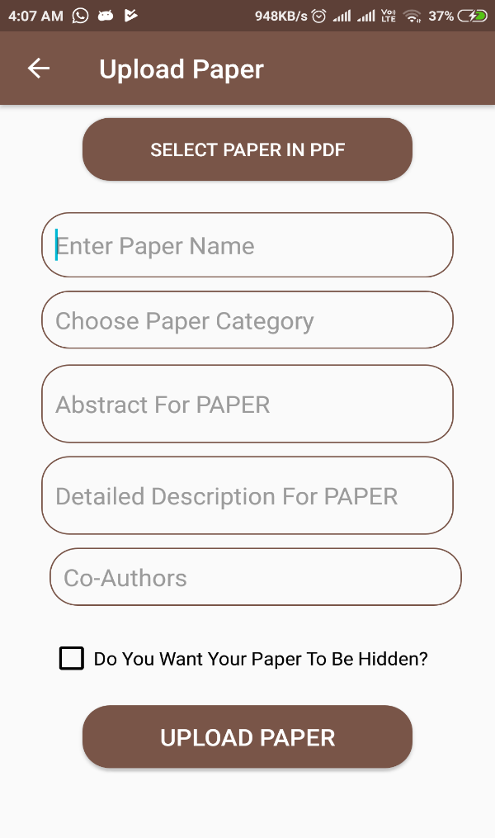
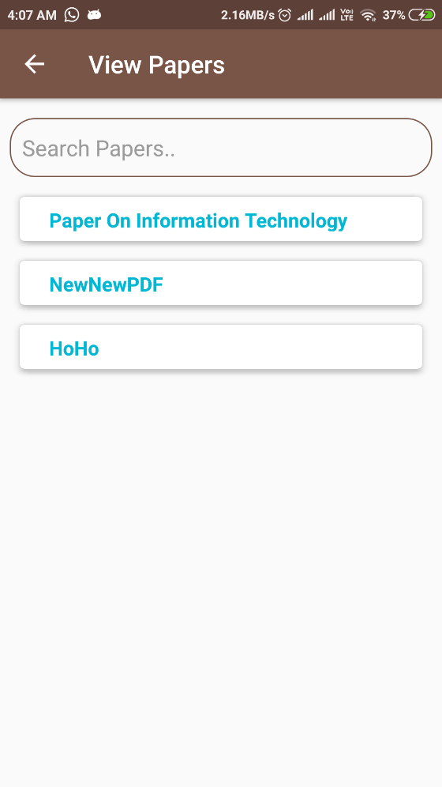
Upload/View Paper
In the Upload Paper section, users or researchers can upload their papers in .pdf format by giving Paper name, category, abstract for paper and long description. They can also check whether to make their paper public to all users for download or to restrict download access rights.
In the view papers section, the users can view all the papers they have uploaded and also search from those uploaded papers.

Slide 19
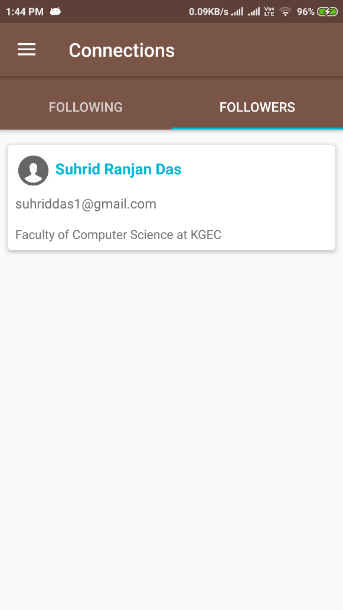
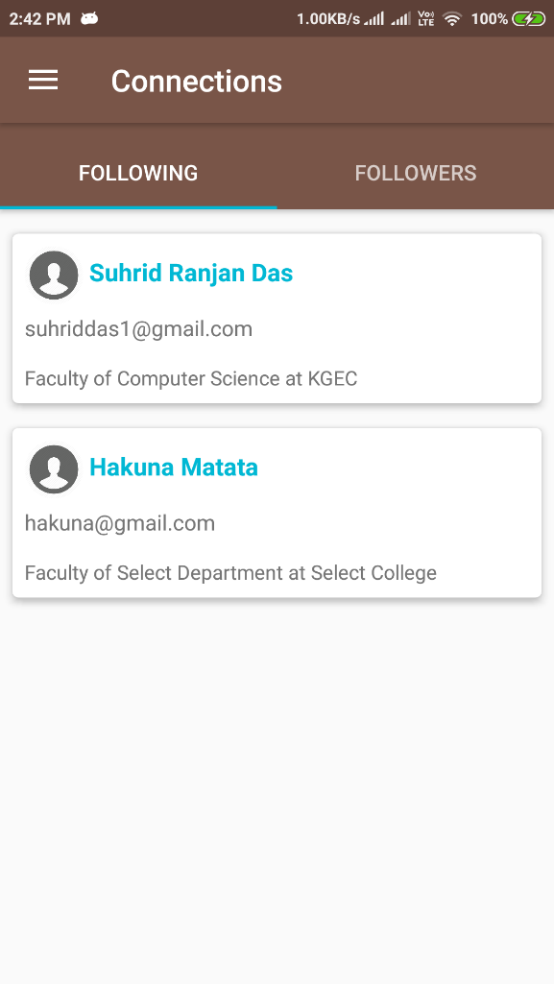
Connections
The current user or researcher may find the works of some other user or researcher to be very intriguing and would like to view all his/her works in the News Feed. For this to happen, the researcher can follow the other researcher. All users can follow the researchers of their interests.

Slide 20
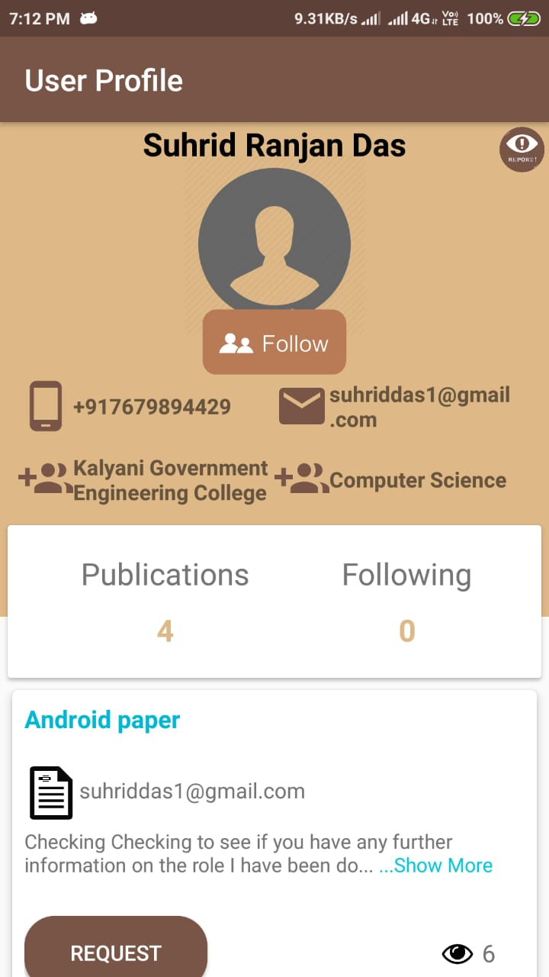
User Profile
User Profile is the section where the current user can view the information about other user’s or researchers, can view their works, download the full paper or request for download. The current user can also follow different other Researchers so as to get their works on his/her News Feeds.

Slide 21
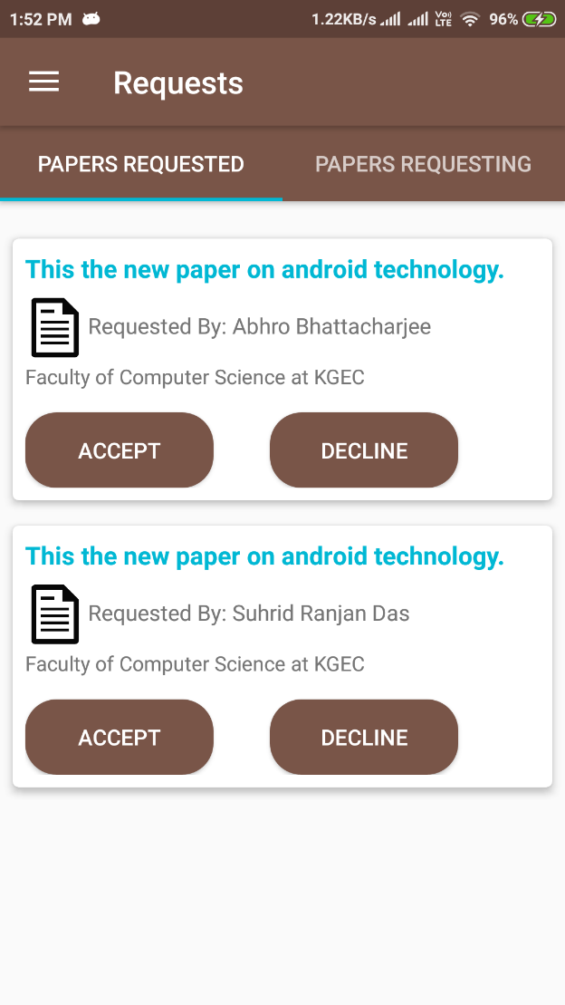
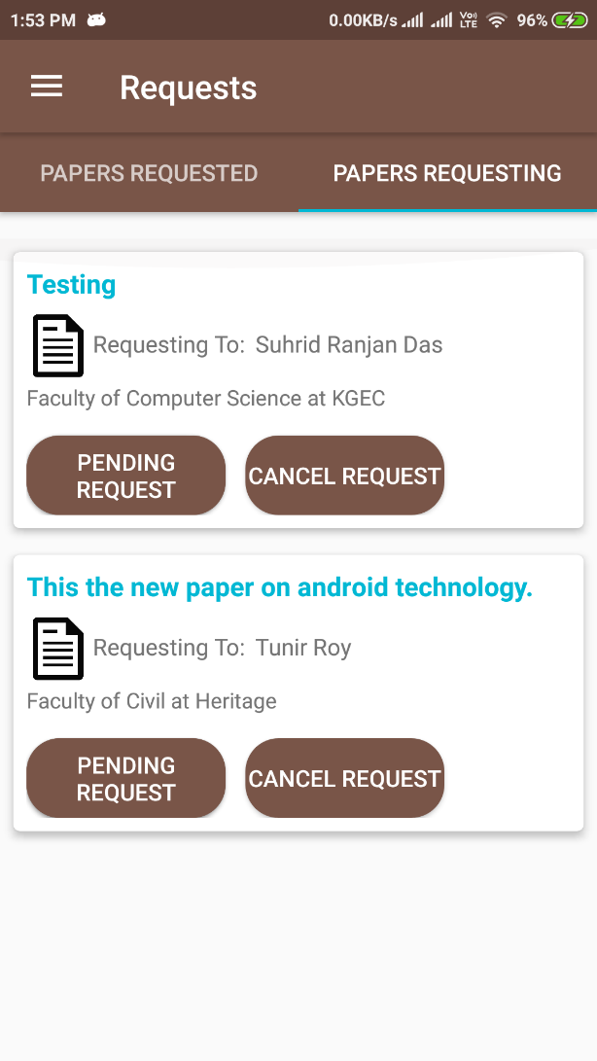
Requests
There are two areas of the Requests section, the “REQUESTED PAPERS” tab, where all requests from different researchers or users are displayed for the download access to the papers which are download restricted and the “REQUESTING PAPERS” tab where all the requests to download papers of the current user is displayed. The user can either accept the request of the other users or can decline their request. He/she can also cancel the requests that are still pending or wait for them to either get accepted or declined.

Slide 22
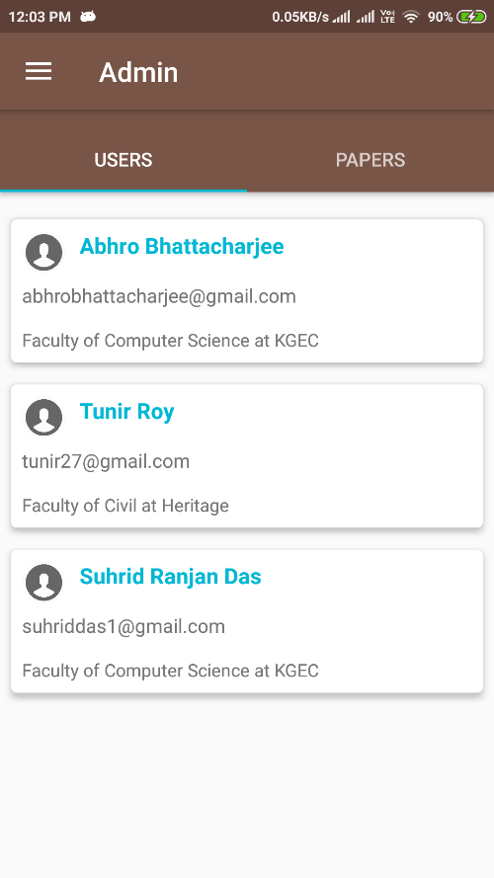
Administrator
The work of administrator is to verify if users and papers if they are valid or not. The administrator has the power to remove reported users and papers.

Slide 23
Future scope
The following are the updates that will be implemented in future:
ID verification like College/University ID card or any other ID proof have to be uploaded during registration process for verification of user.
Implementation of Filter Interests option in the News Feeds section to make the application more flexible.
Citations would be done automatically during paper upload.
Notification system.

Slide 24
conclusion
ResearchIN is primarily developed from the idea to create a social platform for Researchers from all over the world where they can upload their research papers and can view and download other research papers and also get to know the works done of their interests and the people who have contributed towards those works. ResearchIN also provides the facility to find others registered users who are nearby or within a close proximity. This is the unique feature of ResearchIN. It also enables users to search of papers and other researchers with its powerful search option. The ResearchIN android app can run on any Android Smartphone or Tablet and has a very simple and easy to use interface.

Slide 25
acknowledgement
The satisfaction that accompanies the successful completion of any task would be incomplete without the mention of people whose ceaseless cooperation made it possible, whose constant guidance and encouragement crowned all our efforts with success.
We are grateful to our project guides Dr. Indrajit Bhattacharaya for his guidance, inspiration and constructive suggestions that helped us in the successful completion of this project.

Slide 26
references
Web:
https://www.simplifiedcoding.net/
https://stackoverflow.com/
https://developer.android.com/
https://www.researchgate.net/
https://www.academia.edu/
https://in.000webhost.com/
Source Code Link: https://github.com/suhrid01/ResearchIN

Slide 27
THANK YOU

